Slide 1
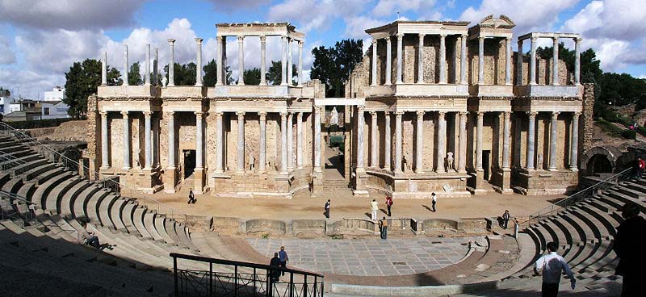
Conventions of
Roman Drama
By: Miriam Colon
Period 5

Slide 2
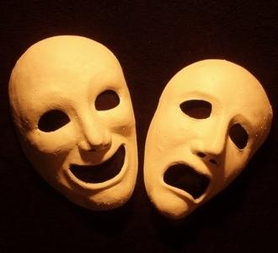
3 Major Phases of Development:
Early period (pre-240 BCE) when native Italian drama, such as Atellan farces, phlyaces and Fescennine verses, dominated the Roman stage;
2) the period of literary drama (240 BCE - ca. 100 BCE), when the Romans primarily adapted classical and post-classical Greek plays;
3) the renaissance of popular entertainment (ca. 100 BCE - 476 CE), when traditional Roman fare like circuses, spectacles and mime returned to the entertainment scene.

Slide 3
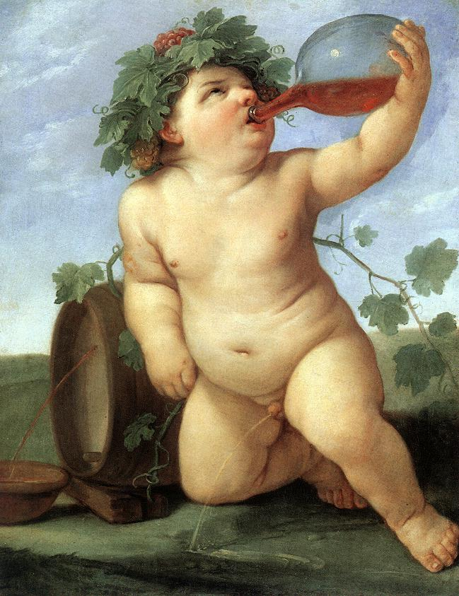
Bacchus!
Patron god of roman theatre
Same as Greek Dionysus
God of harvest, grapes, fertility and theatre
Associated with the festival of Bacchanalia- infamous for the Roman orgies (prostitution) and highest degree of immoral behavior.
Roman theatre was usually associated with the religious festivals of pagan gods.

Slide 4
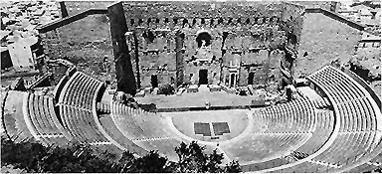
Structure
Orchestra: Paradoi become vomitorium into orchestra and audience
Praecinctio: Roman corridors; separated the galleries of a theatre and were used for walkways.
Cavea:
Wedge- shaped seating sections,
built on hill
or slope.
Auditus: entrance, important in order to safely handle the attendance.
Stage house was located behind the stage(where supplies were kept
scaena frons – facade of the stage house

Slide 5
Facts about Roman Theatre :
Actors/ performers were
called “histriones”
3 major influences on Roman theatre:
Greek Drama
Etruscan influences (circus-like elements)
Fabula Atellana –Atellan farces
(plays that contained lots of low comedy and rude jokes)
Some of the stock characters:
-Bucco: braggart, boisterous
-Pappas: foolish old man
-Dossenus: swindler, drunk, hunchback

Slide 6
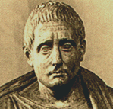
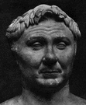
-Forms of Roman Theatre-
Roman Drama
-Livius Andronicus: 240-204B.C
– wrote and translated comedies and tragedies.
-Gnaeus Naevius: 270-201B.C
– excelled at comedy. But wrote both comedy and tragedies.
Both helped “Romanize” drama by introducing Roman allusions into Greek originals and used Roman stories

Slide 7
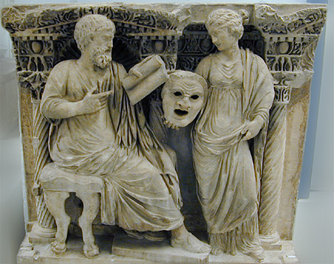
Characteristics
Comedy vs. Tragedy
Chorus was abandoned
No act or scene divisions
Everyday domestic affairs
Action placed in the street
5 episodes – acts divided by choral odes
Elaborate speeches
interest in morality
violence and horror were portrayed onstage
Characters dominated by single passion (ex. Hate)
interest in the Renaissance

Slide 8
Works Cited!
3 forms of development:
http://www.usu.edu/markdamen/ClasDram/chapters/131romtheatre.htm
Structure & Bacchus:
http://www.roman-colosseum.info/roman-life/roman-theatre.htm
Facts
http://novaonline.nvcc.edu/eli/spd130et/roman.htm#roth

